Slide 1
1:1 Sex Offenses 2014
Janine White
6/30/2016
IEE578 Regression Project
Professor Douglas Montgomery
Arizona State University

Slide 2
Data
Data for this project are from Uniform Crime Reporting Program Data: National Incident-Based Reporting System, 2014 (ICPSR 36398).
Data analyzed was limited to incidences involving sexual offenses with one victim and one offender reported in 2014.
The objective of this analysis is to explore how available characteristics relate to time to arrest if an arrest was made.
Citation
United States Department of Justice. Federal Bureau of Investigation. Uniform Crime Reporting Program Data: National Incident-Based Reporting System, 2014. ICPSR36398-v1. Ann Arbor, MI: Inter-university Consortium for Political and Social Research [distributor], 2016-03-21. http://doi.org/10.3886/ICPSR36398.v1

Slide 3
Considerations
Sex offenses are shame inducing and likely to be committed by someone the victim knows.
Only about 1/3 of rapes are reported. Less than 1% lead to arrest or incarceration. (RAINN Criminal Justice: Statistics)
These data only represent those that have been reported to the police in a standardized data set. Significant details about the officer and case are not included, so the overall R² of the model is expected to be small.

Slide 4
Incident Demographics

Slide 5
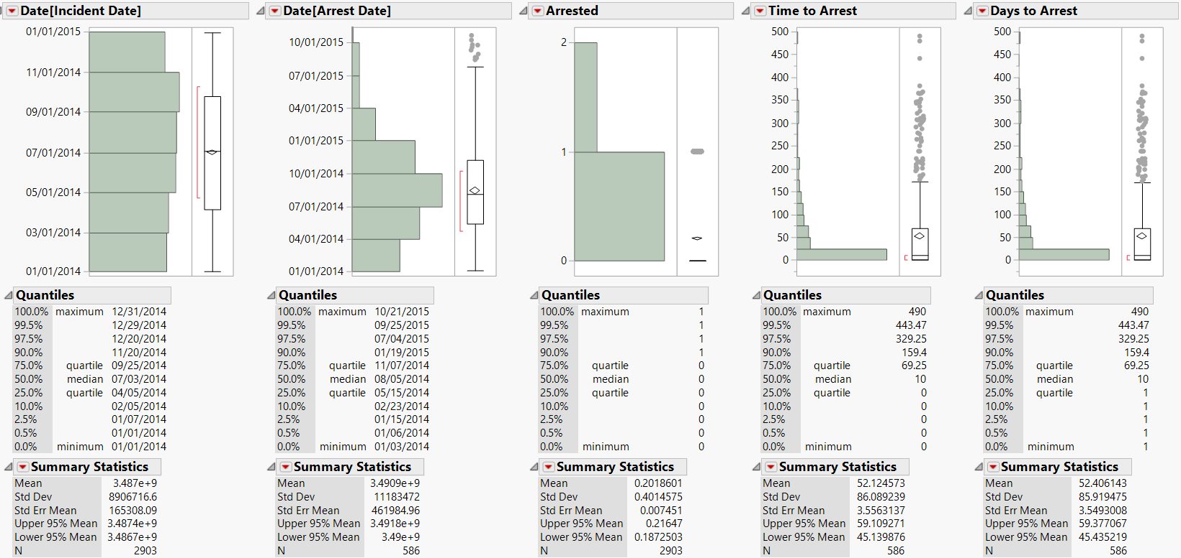
Incident and Arrest Dates
2903 1:1 sex offenses were reported in 2014.
20.19% of reports resulted in arrests (n = 586).
While reports of sexual offenses occurred evenly throughout the year, arrests followed a skewed distribution, peaking in August.
Time to arrest was recoded so that when arrest occurred on the same day as the incident, time = 1, rather than 0,to allow for explorations of transformations without losing data.
The average time to arrest, when it occurred, was 52 days, which was not affected by the recode.

Slide 6
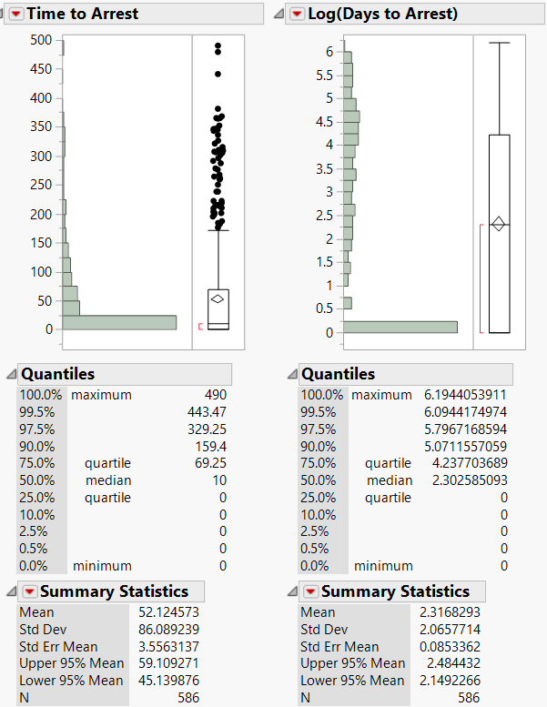
Skewed Time to Arrest
The time to arrest is skewed such that if arrests take place they tend to occur very quickly. The distribution was refactored by the log function for regression analysis.

Slide 7
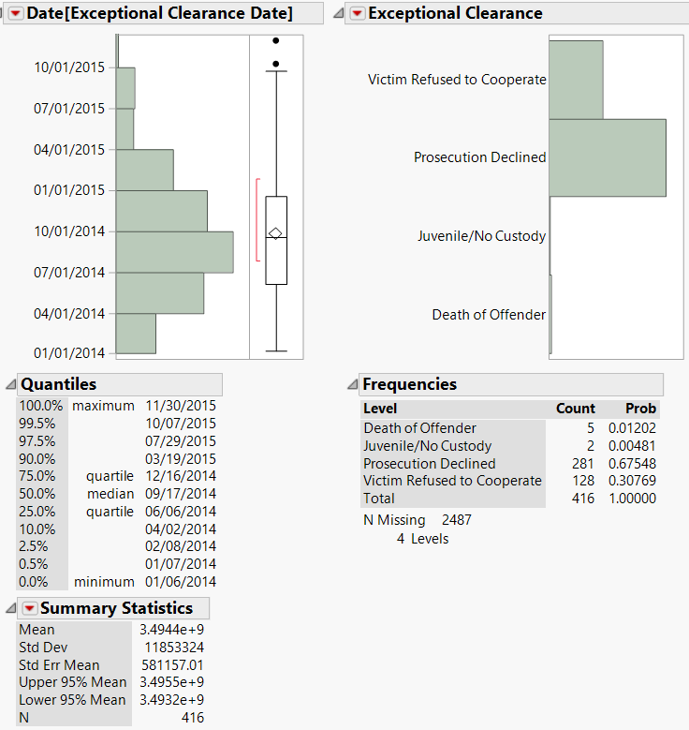
Exceptional Clearance
For an offense to be cleared exceptionally the following conditions must be met. The agency must have:
Identified the offender.
Gathered enough evidence to support an arrest, make a charge, and turn over the offender to the court for prosecution.
Identified the offender’s exact location so that the suspect could be taken into custody immediately.
Encountered a circumstance outside the control of law enforcement that prohibits the agency from arresting, charging, and prosecuting the offender.
14.3% of 1:1 sex offenses cases were cleared exceptionally, compared to 47.4% of violent offenses.
The date distribution of exceptionally cleared cases is similar to arrests.
Of cases cleared exceptionally, 67.5% were due to prosecution being declined and 30.8% are due to the victim refusing to cooperate.
Exceptionally cleared cases are not considered arrests and not included in time to arrest modeling for this project.
Citations
Uniform Crime Report, Crime in the United States 2014, Offenses Cleared. Rep. Federal Bureau of Investigation, n.d. Web. 24 June 2016. <https://www.fbi.gov/about-us/cjis/ucr/crime-in-the-u.s/2014/crime-in-the-u.s.-2014/offenses-known-to-law-enforcement/clearances/main/clearances.pdf>.
"Offenses Cleared." Uniform Crime Reports. Federal Bureau of Investigation, 27 June 2011. Web. 24 June 2016. <https://www.fbi.gov/about-us/cjis/ucr/crime-in-the-u.s/2010/crime-in-the-u.s.-2010/clearances>.

Slide 8
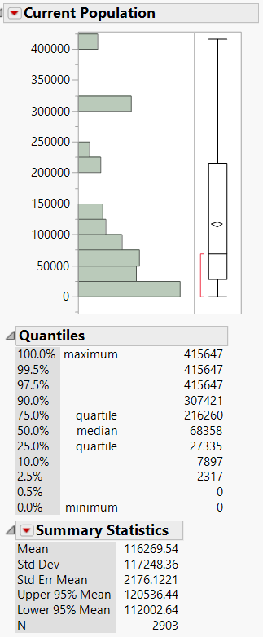
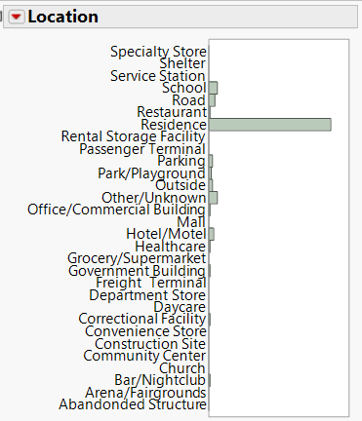
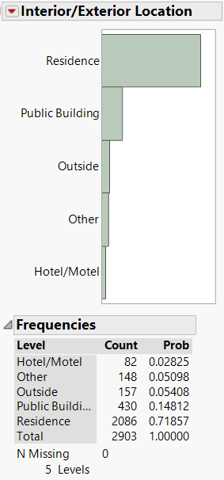
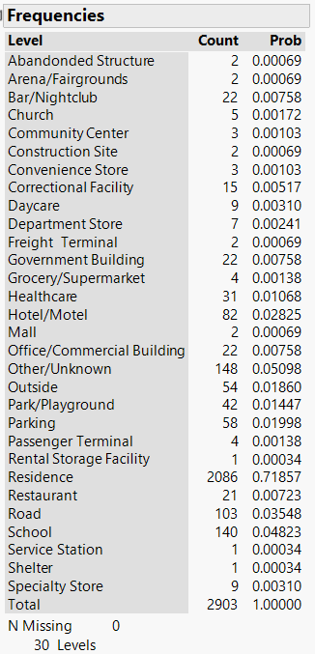
Location
The average population in the area where the offense occurred is 116269.
Offenses were most likely to take place in a residence.

Slide 9
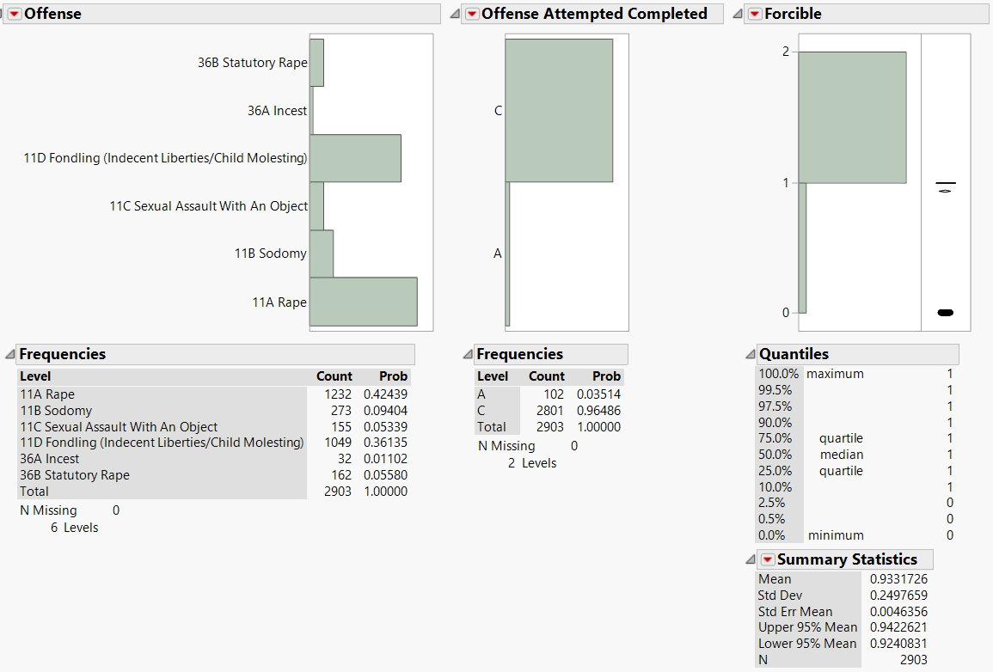
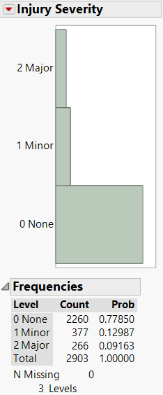
Sex Offenses
Sex offenses may be forcible – Rape, Sodomy, Sexual Assault With An Object, and Fondling – or non forcible – Incest and Statutory Rape.
93% of reported offenses were forcible.
96% of reported offenses were completed.
77.9% reported no injuries.
Because Forcible is a recode of Offense and Injury Severity had a correlation of 75%, Forcible was dropped from the analysis.

Slide 10
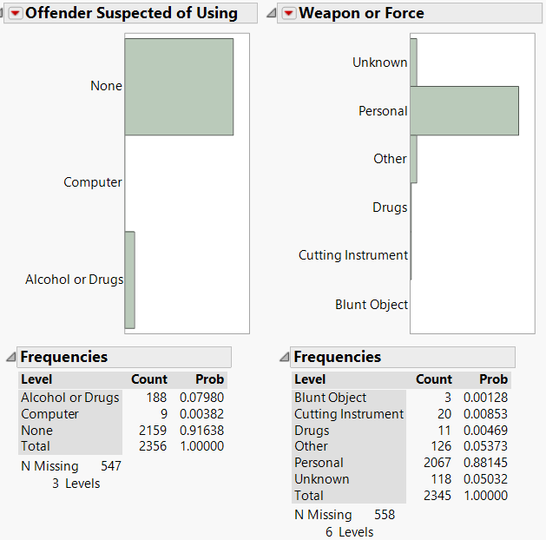
Forcible Sex Offenses
Only about 10% of forcible sex offenses involve the use of alcohol, drugs, computers, or something other than personal force.

Slide 11
Victim and Offender Demographics

Slide 12
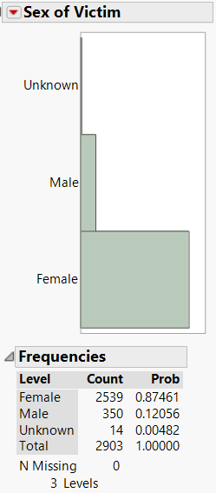
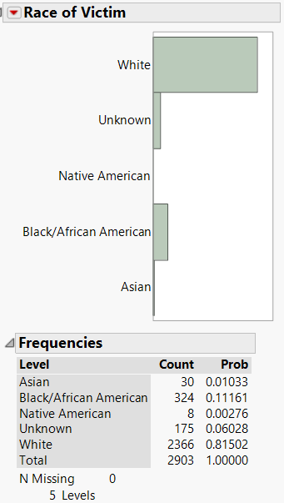
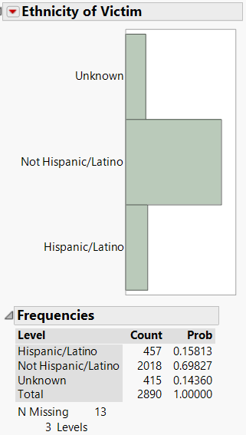
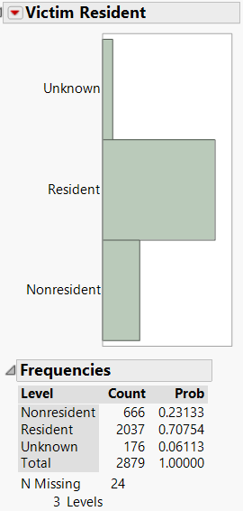
Victim Demographics
87.5% Female
81.5% White
69.8% Not Hispanic / Latino
70.8% Resident

Slide 13
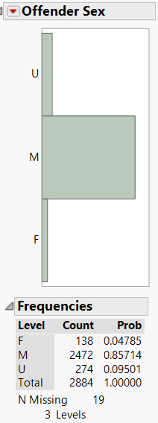
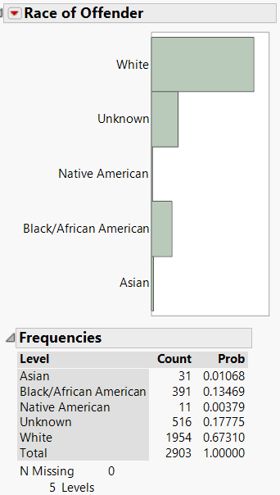
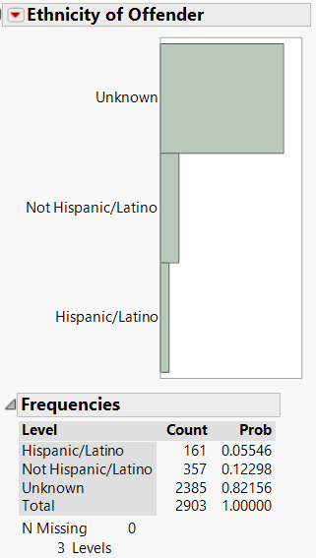
Offender Demographics
85.7% Male
67.3% White
Of those with known ethnicity, offenders are 2.2 x more like to be non-Hispanic than Hispanic

Slide 14
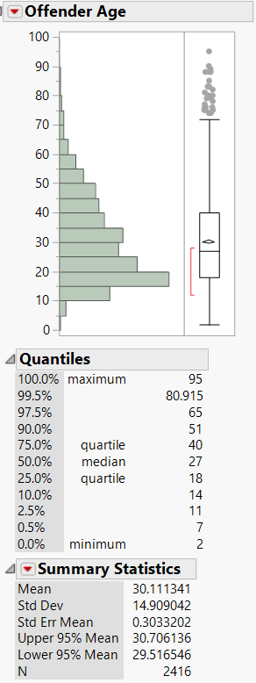
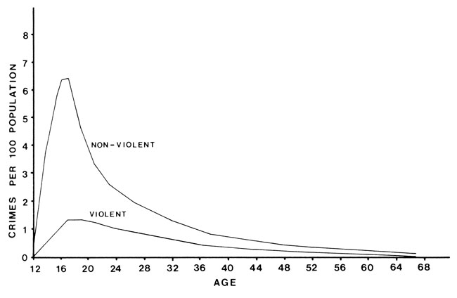
Offender Age-Crime Curve
The offender age distribution follows the expected age-crime curve for most offenses, peaking in the late teens and falling off thereafter.
Offenders in this data set were an average or 30 years old with 0 recoded to missing.
Victims are typically younger than offenders.
Farrington D. 1986. Age and crime, in Tonry M & Morris N (eds), Crime and justice: An annual review of research. Chicago: University of Chicago Press: 189–250.

Slide 15
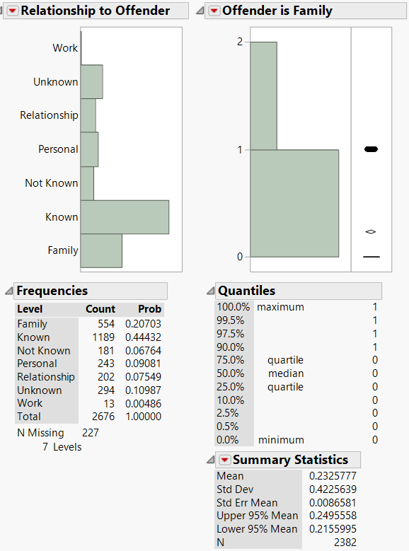
Victim Offender Relationship
The victim-offender relationship variable was recoded to simplify the interpretation. Unknown and blank are coded as missing.
Where the relationship is understood, 92.4% of victims know their offender in some way. 20.7% of offenders are family.

Slide 16
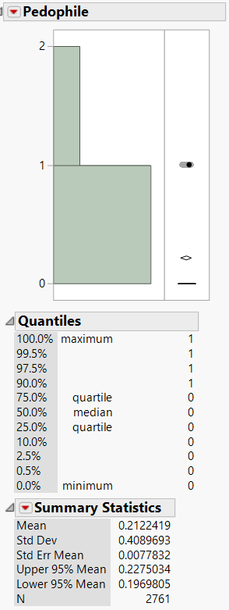
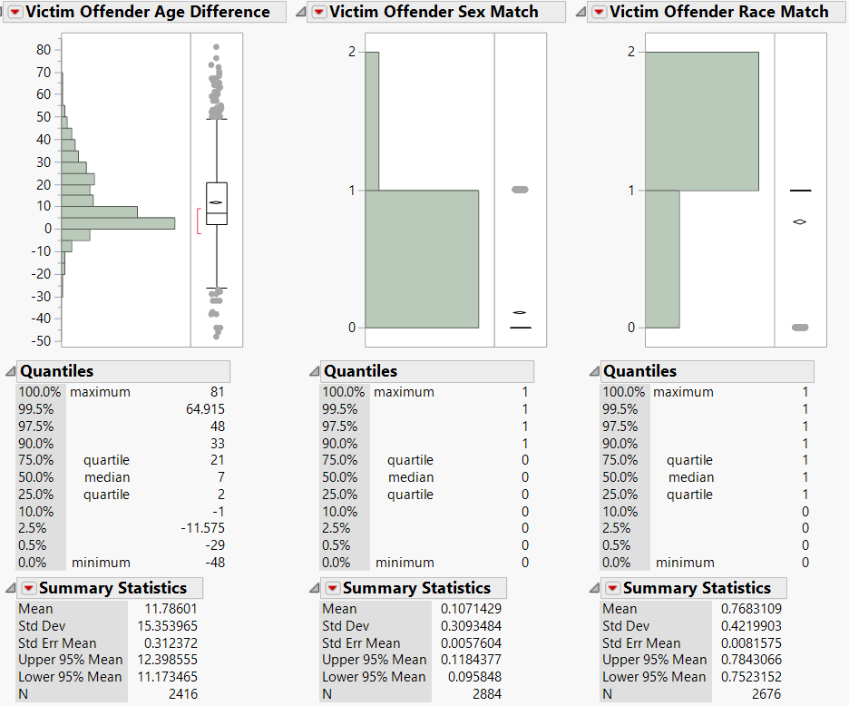
Victim Offender Matching
For incidences where the characteristics of the offender are identified:
Victims are 11.8 years younger than the offender on average.
21.2% of the offenses meet the criteria for pedophilia – victim >= years old and offender >=16
Sex matching is interesting because there may be bias against homosexuals or homosexual attacks.
10.7% of victims are the same sex as the offender.
By victim sex, matching is:
Female 2.5%
Male 69.9%
76.8% of victims are the same race as the offender.
By victim race, matching is:
White 81.2%
Black/African American 72.1%
Native American 25%
Asian 24%
Unknown 34.4%
Unfortunately, offender ethnicity is missing for most incidences.
These statistics were not used in the regressions because of multicollinearity issues, but interactions were tested and found not to be significant.

Slide 17
Regression Analysis

Slide 18
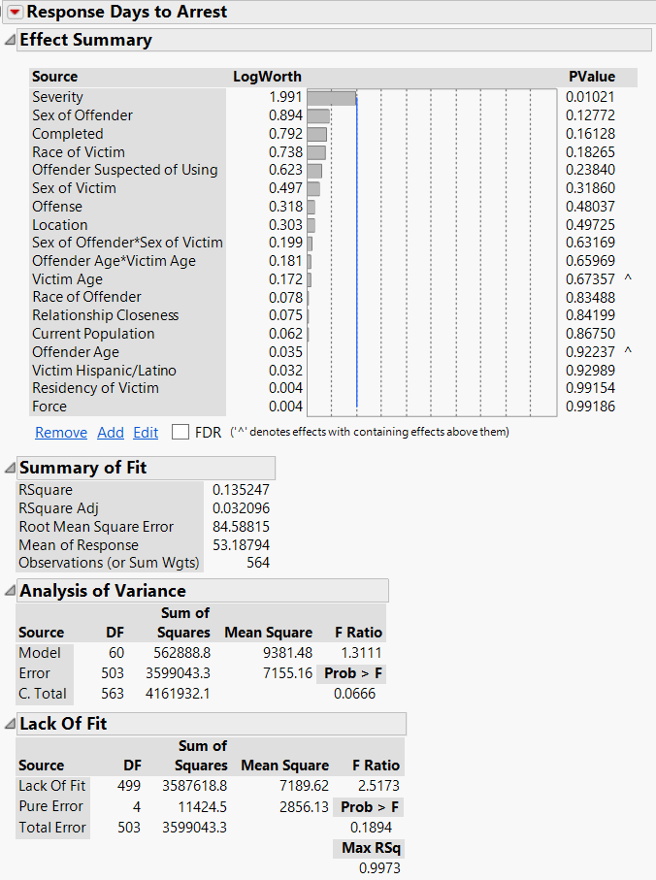
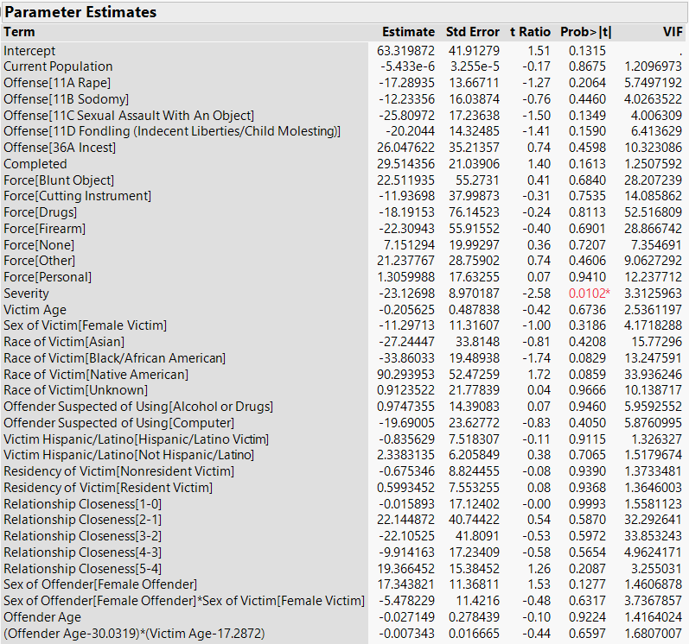
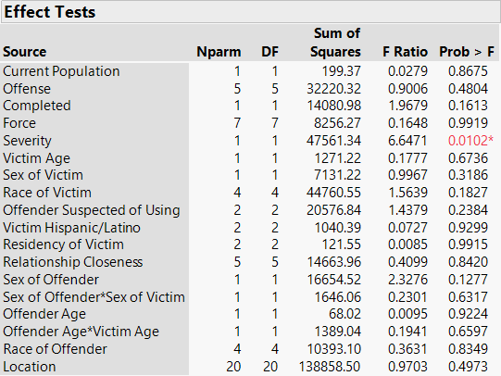
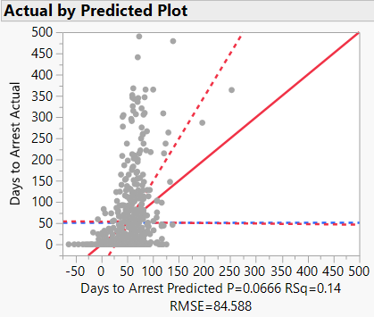
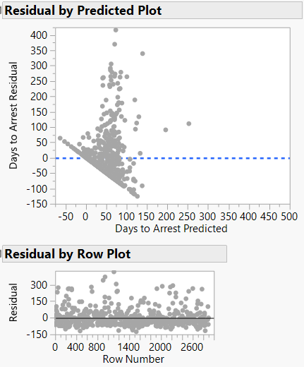
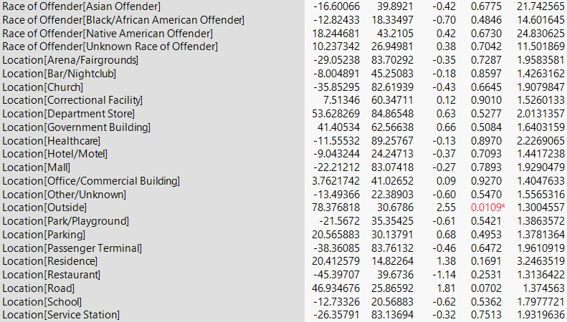
Linear Full Model of Days to Arrest

Slide 19
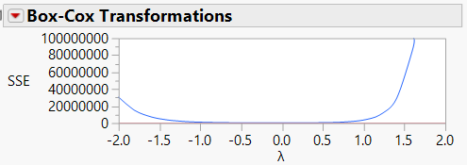
Linear Full Model of Days to Arrest
The initial full model of days to arrest is significant with an adjusted R² of 0.032. However it is clear that the model is over specified and the dependent variable has a heavy tail. When arrests occur, they tend to occur very quickly within the first day or over a much longer time period.
Evaluating the Box-Cox Transformations, log transformation of days to arrest is likely to improve the model. Changing the dependent variable to log(Days to Arrest) increases the adjusted R² to 0.12.
The model was also broken down into incidence, and victim and offender characteristics models to narrow down the variables to be included.

Slide 20
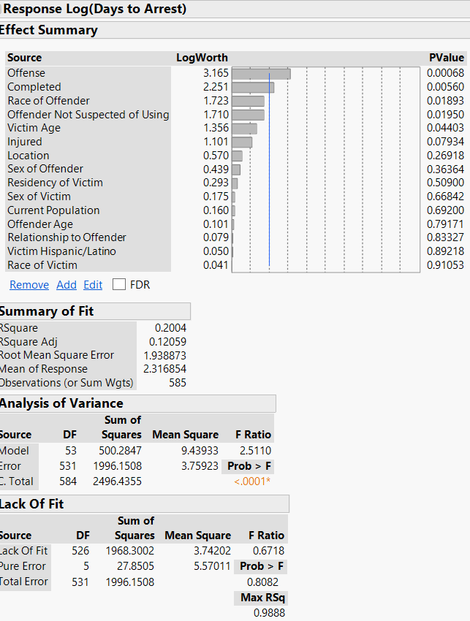
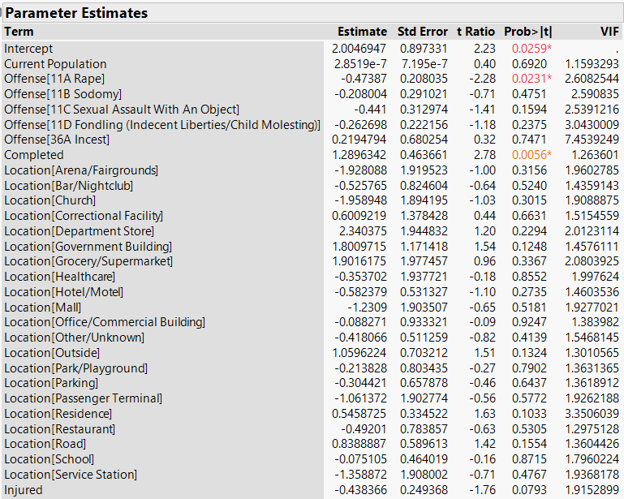
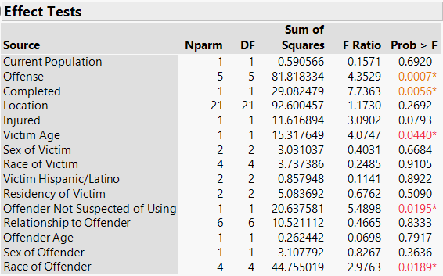
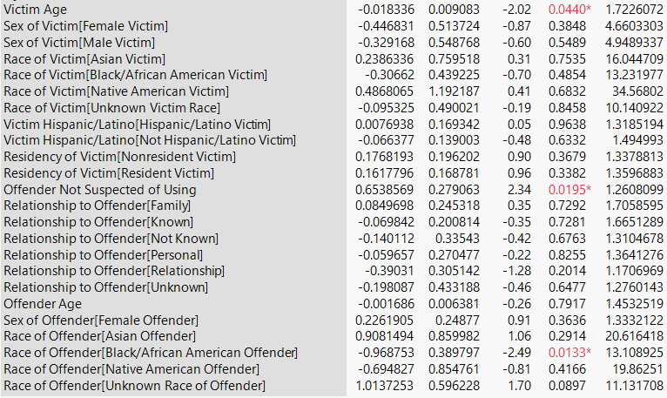
Log(Days to Arrest) Full Model

Slide 21
Stepwise Regression
Using stepwise regression, P-value threshold of 0.1/Mixed/Restrict, the following variables are identified as significant:
Victim Age
Offense
Location
Completed
Race of Offender
Offender Suspected of Using
Injured

Slide 22
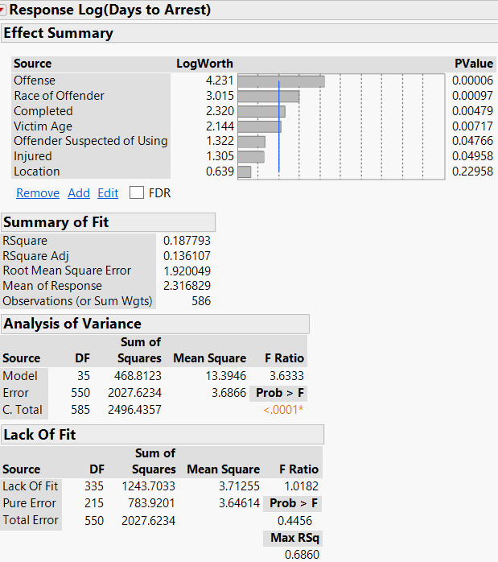
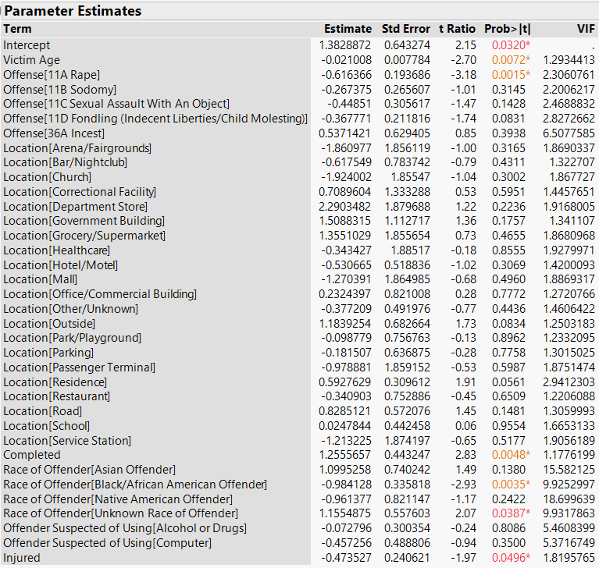
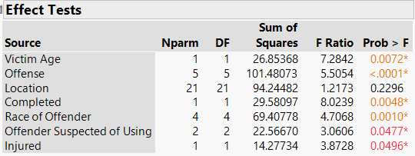
Standard Log(Days to Arrest) Reduced Model
Removing Location, which is not significant, reduces adjusted R² to 0.129.

Slide 23
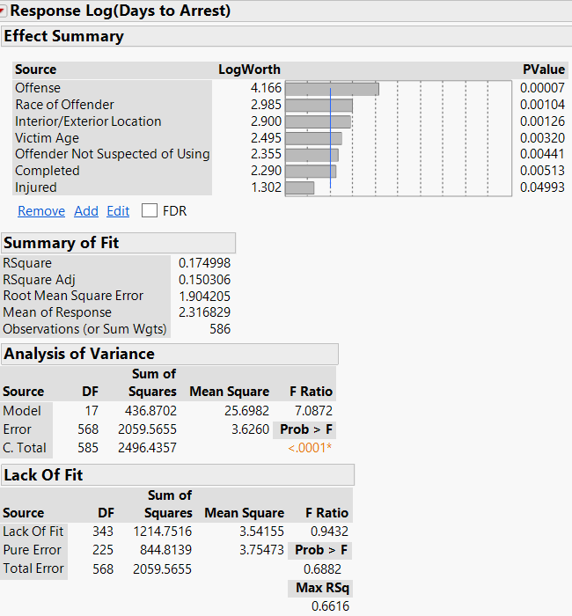
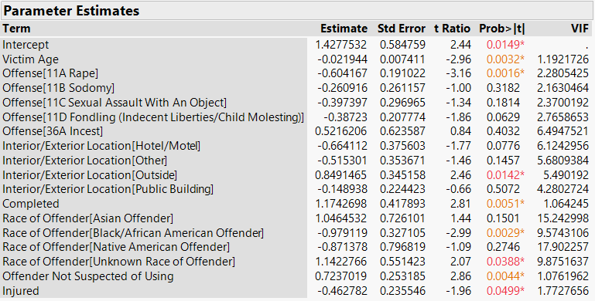
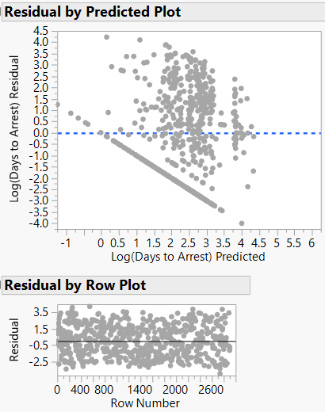
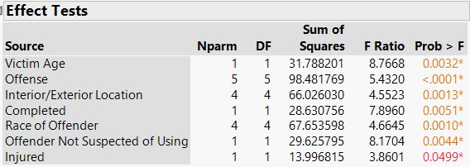
Consolidated Location Model
Consolidating location categories shows that Outside location is influencing the significance of location.
Residuals by predicted are skewed, which is not surprising given the low R² of the model, but the residuals by row are randomly distributed indicating that the variance that is explained by the model is useful.

Slide 24
Discussion
The final equation for the model is
Because of the low explanatory power of the model the direction of the parameters is more important than the size of the parameters.
Arrests are likely to take less time the younger and more injured the victim. Arrests are likely to take longer when the sex offense was completed or involves incest, the offender was not suspected of using anything, for example, drugs, alcohol or computers, when the location of the incident was outside, and when the offender is Asian or of unknown race.
The findings of the model are consistent with real world practices. Officers have more compassion for younger victims and those who have been injured. It will be more likely that there is supporting evidence for conviction when the offender did not use intoxicants or computers. It will be less likely that there is supporting evidence when the incident occurs outside or the offender is unknown. Arrest is likely to take longer in the case of incest because people are ashamed to admit that they have been sexually molested by family and are likely to have difficulty cooperating with law enforcement, even when they want to. Perhaps the time to arrest is longer when the sex offense is completed because there is more likely to be physical evidence and many laboratories are known to have large back logs of evidence to evaluate. Asian offenders may take longer to arrest because they tend to live in tight knit communities that may not cooperate well with investigations.
It would be helpful to have more details about the incidences and investigations to increase the explanatory power of the model. It may also be helpful to use another transformation for such a heavy tailed distribution of time to arrest. Future investigations could consider the factors affecting whether or not an arrest occurs, not just time to arrest.

